Slide 1
Intelligent Log Analysis
Logs are intended to be read by humans, and, thus, not easily machine-processable. Nonetheless, to apply AI/ML methods, logs need to be parseable. Structured logs have a structured format which can be readily parsed by a algorithms without needing complex regular expressions to parse the log message or technique to identify key/value pairs.
Lecture at Technical University of Berlin
Jorge Cardoso
Chief Engineer for Hyperscale AIOps
Munich Research Center
2020.12.23
2020.12.23

Slide 2
Intelligent Structured Log Analysis Description
Background. Application logs were originally introduced to assist developers to debug software systems. Logs enabled to troubleshooting systems by offering a view into the states that are reached and traversed while systems are in operation.
Problem. In the past, humans have been part of the process of interpreting logs. The contents of logs were specified (often using printf), read and understood by humans. Technological advances and large-scale system complexity have dramatically increased the volume of logs generated. This volume compels to adopt AI/ML methods for processing. Unfortunately, existing log formats were designed to be human understandable and not AI/ML parseable. For example, while a human can easily understand the meaning of the log message: “Apr 25 14:01:12 user Throughput exceed 20Gbps and 7Mpps in 35% of last 15 minutes, above the time threshold 10%!”, its parsing and understanding by AI/ML methods is expensive, complex and possibly inaccurate since it is difficult to distinguish and identify domain knowledge, properties, values, taxonomies and categorical data. In other words, extracting feature vectors from logs is a nontrivial, however critical, procedure that exerts influence on the efficacy of AI/ML algorithms.
Approach. A new approach proposes to move away from unstructured logs into structured logs since their format can be readily parsed by AI/ML algorithms without requiring complex techniques to identify feature vectors. Structured logs are typically written in a format such as JSON, CSV, XML, and RDF that can be easily parsed and processed. For example, log records containing I/O request rate, request length, queue size and other properties can be exploited to build models for storage throughput and latency. As another example, the use of feature vectors to identify system states provides a new way to discover relationships between components by looking at uncommon states which are correlated when failures occur.
Results. Structured log analysis provides a novel event infrastructure which will enable to make additional progress in the fields of usage analysis, performance modelling, anomaly detection, failure diagnosis and security.

Slide 3



Log Analysis Problem Definition
Take Away
Since traditional log protocols (e.g., syslog, RFC 5424) where mainly developed to be human readable, their processing by AI/ML techniques is complex
Machine Readable Data: A format that can be easily processed by a computer
Marked up human-readable
HTML, microformats, RDFa, etc.
Intended for machine processing
CSV, XML, JSON, RDF, etc.
Using machine readable data is a better approach for log analysis using AI/ML
Log record
Human Readable versus Machine Readable Data
Humans can easily understand this text, but for machines it is complex
Apr 25 14:01:12 user Throughput exceed 20Gbps and 7Mpps in 35% of last 15 minutes, above the time threshold 10%!
Human readable
Requires expensive, complex, possibly inaccurate modifications
Machine processable
Difficult to identify properties and values
Simple
AI/ML
Machine readable
[1] tools.ietf.org/html/rfc5424

Slide 4
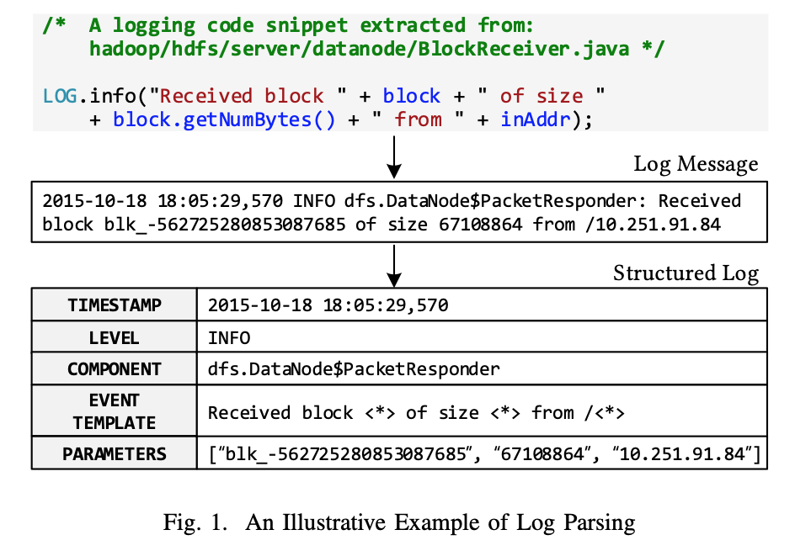
Log Analysis Applications
Usage analysis [1]
User behaviour analysis (e.g., Twitter [1]), log-based metrics counting (e.g., Google Cloud [32]), and workload modeling (e.g., Microsoft [33])
Requires log parsing
Performance modeling
Facebook [3] uses logs for performance improvements
Requires log parsing
Anomaly detection
PCA [18], invariant mining [34], and deep learning [10]
Requires log parsing
Duplicate issue identification
System issues (e.g., disk/network errors) often recur or can be reported by different users, leading to many duplicate issues
Microsoft has reported some studies [11], [35], [36] on this task
Requires log parsing
Failure diagnosis
Recent progress [4], [37] has been made to automate root cause analysis based on machine learning techniques
Requires log parsing
Challenge
Transform unstructured logs into structured logs
Existing Approaches
Handcrafted regular expressions or grok patterns [2] to extract event templates and key parameters: time-consuming and error-prone
Automated log parsing using data-driven such as SLCT, LogCluster, IPLoM, LKE Spell, Drain: approximated and computationally expensive
[1] Tools and Benchmarks for Automated Log Parsing, Jieming Zhu, et al.
[2] https://logz.io/blog/logstash-grok

Slide 5
Structured Logging Overview
Take Away
Generate machine readable log files to supported advanced analytics for anomaly detection and root-cause analysis
When a log record contains only a string message, it is called unstructured: complex to process by AI/ML methods
Unstructured Logging
Limitations of Unstructured Logging
Complex parsing to extract properties and variables
Requires template mining (e.g., using Drain algorithm)
Structured Logging
Logs are written in a structured format (e.g., JSON) that can be easily parsed and processed using AI/ML
Technical Benefits
Log processing. key/value pairs, explicit numbers vs strings, and support for nested data structures enable structured logs to be easily processed by AI/ML
System monitoring. Easily generate charts to analyze behavior
Data anonymization. Easily change log records to hidden confidential information
Log searching. Enables to easily search and correlate log messages
With structured logging: clientid: 12345
With unstructured logging: SELECT text FROM logs WHERE text LIKE ”Customer %"
log.Debug(“Response time customer ” + 1234 + ‘ ‘ + 55 + ‘ms’)
DEBUG 2017-01-27 – Response time customer 1234 55ms
Parsing is done using, e.g., SLCT, LogCluster, IPLoM, LKE Spell, Drain, etc.
Structured Logging
log.Debug(“Response time customer ”, new {clientid=1234}, {rt={d…:55, unit: “ms”}))
DEBUG 2017-01-27 – Response time customer {"clientid": 1234}
{”rt": {‘duration’:55, ”unit": ‘ms’}
{ "time": "2010-01-01 12:34:56.0000",
“msg”: “Response time customer ”,
"clientid ": ”1234",
”rt": {
“duration”: 55,
“unit”: “ms”}
}
Serialize the entire message and additional metadata as JSON

Slide 6
Structured Logging Implementation
Take Away
Structured logging libraries exist for most languages. Google also provides a solution
https://cloud.google.com/logging/docs/structured-logging
Python
Structured logging can be easily implemented in Python or use a specialized library such as structlog [1]
Simple implementation in Python [2]
Using package structlog [1]
import json import logging class StructuredMessage(object): def __init__(self, message, **kwargs): self.message = message self.kwargs = kwargs def __str__(self): return ‘{%s: %s}' % (self.message, json.dumps(self.kwargs)) m = StructuredMessage # optional, to improve readability logging.basicConfig(level=logging.INFO, format='%(message)s') logging.info(m('message 1', foo='bar', bar='baz', num=123, fnum=123.456))
import structlog
log = structlog.get_logger() try: raise ValueError("This is the exception message.") except ValueError: log.exception("This is the log message.")
Which results in following log
{"event": "This is the log message.",
"exception": "Traceback (most recent call last)”,
“File”: "/usr/bin/decision_tree.py“,
“Line”: 27,
“Module”: “__main__” ,
“Exception”: “ValueError("This is the exception message.")”}
Which results in following log
{“message 1”: {"fnum": 123.456, "num": 123, "bar": "baz", "foo": "bar"}}
Note: approaches such as LogAdvisor [3] can help developers to write log statements
[1] https://github.com/hynek/structlog/
[2] https://docs.python.org/2/howto/logging-cookbook.html#implementing-structured-logging
[3] Learning to Log: Helping Developers Make Informed Logging Decisions -- LogAdvisor -- Jieming Zhu

Slide 7
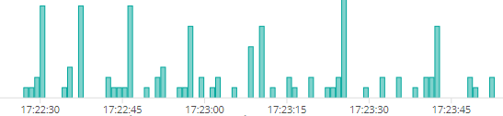
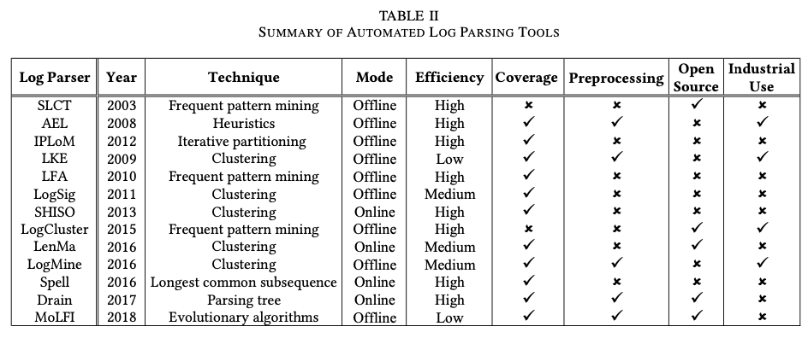
Log Parsing Problem Definition
2019-07-10T15:23:52.264 18550 ERROR oslo.messaging._drivers.impl_rabbit [-] [fa5b6584-eb05-4a8a-bce2-356a66a218cb] AMQP server on 192.168.5.151:5672 is unreachable: timed out. Trying again in 8 seconds.: timeout: timed out
1. Import messages from log storage
Access database, e.g., from ELK
2. Preprocessing
Parse content to extract timestamp, pid, log level and variable part
Parse timestamps and fix them
Squash Python stack traces
3. Template Mining
Reconstruct log templates from message content
Collect variables and their values
4. Record’s time-series
Group records by templates and create time-series
5. Classification
Classify time-series as permanent, periodic or isolated
6. Keywords extraction
Extract keywords from templates using NLP
7. Correlation
Find correlations between time series formed by different templates
8. Event reconstruction
Group records into events
Timestamp: 2019-07-10T15:23:52.264
Content: AMQP server on 192.168.5.151:5672 is unreachable: timed out. Trying again in 8 seconds.: timeout: timed out
Complex and Expensive
AMQP server on @VAR1 is unreachable: Trying again in @VAR2 seconds.
AMQP server on @VAR1 is unreachable: Trying again in @VAR2 seconds.
AMQP server on @VAR1 is unreachable: Trying again in @VAR2 seconds.: RecoverableConnectionError: @VAR3
Summary: AMQP server is unreachable
Keywords: AMQP
Rank: 55
For more than 15 years many log parsers have been proposed. Nonetheless, parsing is still expensive (time), complex, and not always yields a high accuracy

Slide 8
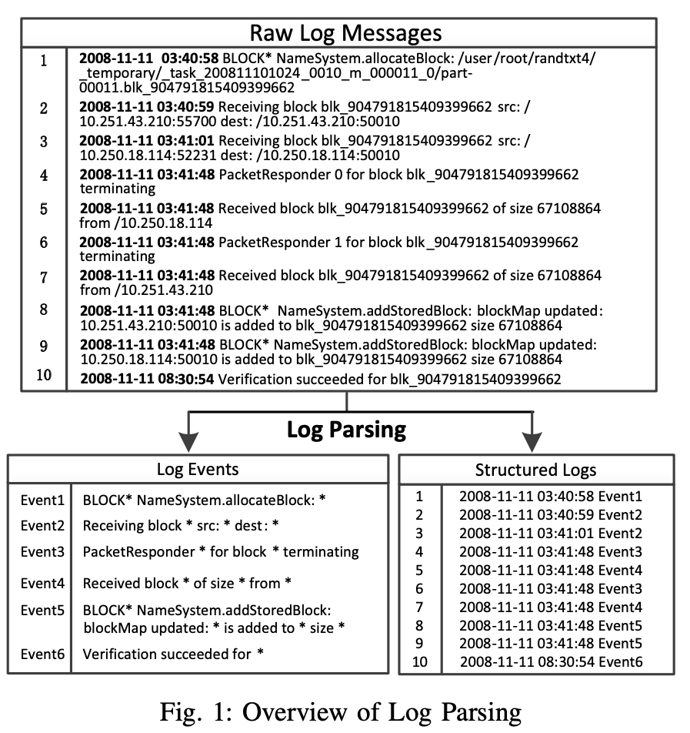
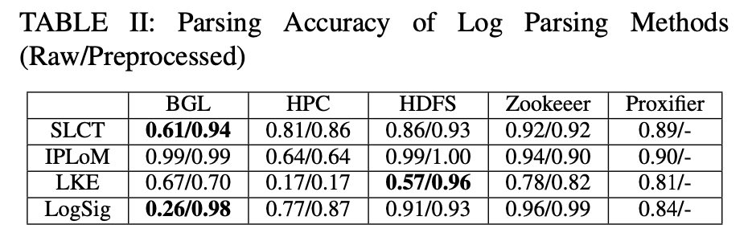
Log Parsing Problem Definition
Limitations
Accuracy for complex raw logs (e.g., HPC) is relatively low: 81%
Application
Log Preprocessing
Use regular expressions to identify special fields, e.g., IP, port, IDs
Generating these events requires sophisticated algorithms
Log Templates

Slide 9
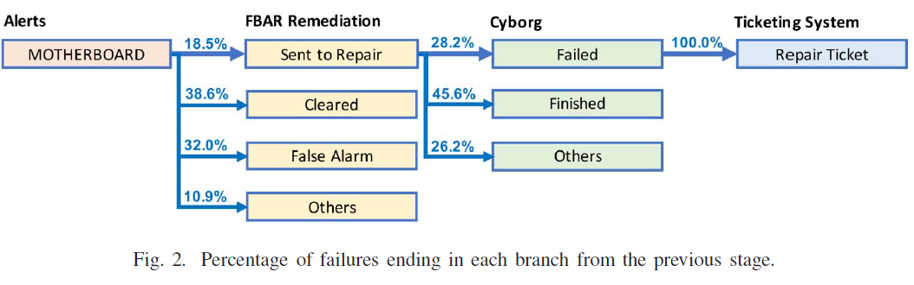
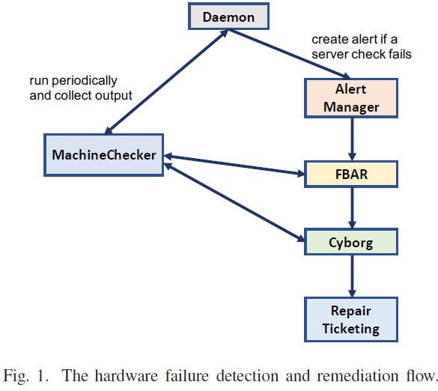
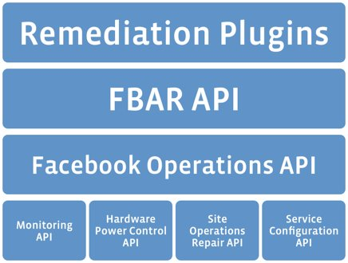
Related Work Facebook
Remediation at Facebook
FB Auto Remediation (FBAR) [1, 2] (2011)
Detect and react to failures
migrating services, rebooting, reimaging or off-lining the machine for manual repair
(Huawei Cloud has Cloud Auto Remediation (CAR) which is rule-base)
100x efficiency
improvement
Benefits of FBAR service
Developed and maintained by 2 engineers
Doing the work of 200 system administrators
Manages more >50% Facebook infrastructure
Overall Procedure
MachineChecker [4]: runs checks periodically (ping, ssh, NIC speed, SMART checks)
FBAR: Once a check fails, an alert is created with failure information
Service owners: write customized remediation for symptoms and set proper rate limits for remediation to make sure there are always sufficient servers running to keep the service up
Cyborg: When none of remediations can fix an issue, FBAR passes case to Cyborg [4] repair engine
Human involvement. Cyborg executes low-level software fixes such as firmware updates. If fix fails: create repair ticket for a technician
Recommendation. Use ML NLP fastText [3] to learn from repair ticket/logs and recommend repair actions
Self-service
Service owners write their own remediation plugins
FBAR uses a simple form of templating to identify states using log files
[1] A. Power, “Making facebook self-healing,” https://www.facebook.com/notes/facebook-engineering/making-facebook-selfhealing/10150275248698920/, 2011.
[2] R. Komorn, “Making facebook self-healing: Automating proactive rack maintenance,” https://code.facebook.com/posts/629906427171799/making-facebook-self-healing-automating-proactiverack-maintenance/, 2016.
[3] A. Joulin, E. Grave, P. Bojanowski, and T. Mikolov, “Bag of tricks for efficient text classification,” arXiv:1607.01759, 2016.

Slide 10
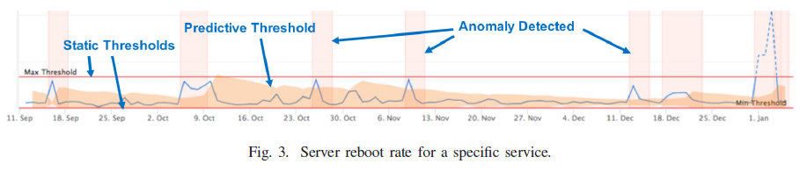
Related Work Facebook
Anomaly Detection
Many false alarms
Alarms when servers are under heavy load
Transient failures
Run CPU, MEM, and network benchmarks to create loads to reproduce transient failures (CoreMark, iperf3, …)
Techniques
Time series, Holt-Winters, exponential, and Gaussian mixture models
Thresholds
Pre-defined static thresholds
Data points outside predictive thresholds
Learned from the time series using machine learning
Recommendations
Use ML to learn from closed repair tickets
Recommend repair actions
Based on how similar tickets have been closed
Use raw text logs as features
Predict the repair actions
Evaluation (undiagnosed tickets)
Recommend up to 5 repair actions for undiagnosed ticket
Correct repair actions: 50% to 80%
Procedure
Identify failure states
Create context for failure
Abstract logs, metrics, traces, events, …
State explosion problem
Aggregates states according to patterns
Map state patterns to recovery scripts
Establish relationships between patterns’ elements and scripts actions
Recommendation
For a given failure, find the matching script
Feedback loop from technitiaon

Slide 11
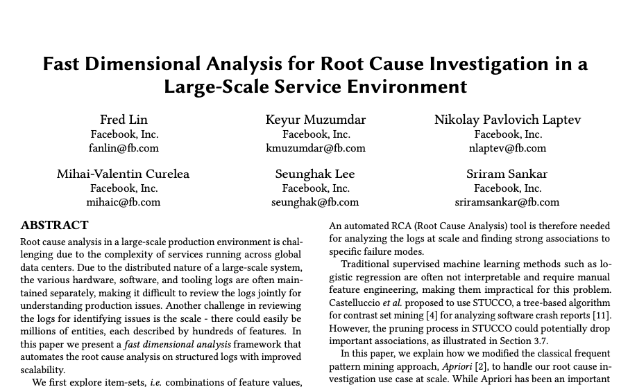
Related Work Facebook
Real-time Automated RCA (Root Cause Analysis)
Used in production at Facebook
Analyzes structured logs to find failure modes associations
Software service logs and Hardware telemetry
Examples
Identify a specific combination of hardware and software configurations correlated to bad reboots
Identify characteristics of a software job that are correlated to exceptions
System architecture
Structured logs are pushed to Scuba in-memory db
Scuba use dimensional RCA
For long-term analytics, logs are stored in HDFS, queried by Hive and Presto
2020
Anomalous Hardware and Software Configurations
Find groups of servers that failed to reboot due to a configuration problem. Root cause analysis
Labeled servers that did not rebooted as positive and the rest as negative
Create dataset with the labels and with >20 service attributes, e.g., model, services, firmware, kernel
Identify attributes correlated with positive/negative labels
Root cause: {firmware version, component model, server model}
Why some servers have bad reboots?
What is the root cause?
AZ1, firmware 3.3, RH2288 V2
AZ1, firmware 3.1, RH2288 V3
AZ2, firmware 2.1, RH2288 V3
AZ2, firmware 3.1, RH2288 V3
AZ1, firmware 2.2, RH2288 V2
JSON
Hardware/software properties

Slide 12
Related Work Commercial Solutions
Platform | Query, filter, Visual. | Template Mining | Log Comparison | Anomaly Detection | Log Correlation | Incident Detection | RCA | Uniqueness
Coralogix | ELK | Loggregation |  | Error spike anomalies |  | Flow anomalies
SumoLogic | Yes | LogReduce | LogCompare
DataDog | Yes | LogPatterns (video) |  |  | Link logs and traces | Transactions (using ID)
SolarWinds Loggly | Yes |  |  | Anomaly detection |  |  |  | Security
Logz.io | ELK | LogPatterns (clustering, video) |  |  |  |  |  | Security
Rollbar | Yes | Grouping/Fingerprinting
Logentries | Yes | RegEx Named Capture Groups |  | Anomaly Alert (rule-based) |  |  |  | SQL-based query language (LEQL)
Oracle Log Analytics | Yes | Log Comparison (clustering) |  | Anomaly Detection (OD) | Time-series correlation
LogicMonitor | Yes |  |  |  |  |  | RCA (topology & metrics)
Elastic.co (ELK) | Yes |  |  | Outlier detection (using counts)
Sematext | ELK |  |  |  |  |  |  | Security, 75+ integration

Slide 13



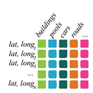
Structured Logging Use Cases and PoCs
Use Case 1: Cloud Log Analysis PoC
Pain point. Log analysis for CLS requires the use of CPU intensive log parsing techniques (e.g., regex and Drain [1])
Technical benefit. Adoption of structured logging will lower CPU processing
Business value. Performance improvement and lower computational resources
Use Case 2: Real-time Error Tracking PoC
Pain point. DevOps cannot be notified easily when their code reaches a specific faulty state in (pre)production
Technical benefit. Real-time close-loop system from Dev, to code execution, to Ops, and to Dev (Dev → Ops → Dev)
Business value. Real-time error monitoring and debugging of services
Use Case 3: Multidimensional Root-Cause Mining PoC
Pain point. It is currently difficult to use logs from CLS for root-cause analysis
Technical benefit. Structured logs enable to extract correlation rules from logs to conduct root-cause analysis
Business value. Lower troubleshooting time for service failures by 80%
Use Case 4: Cloud Log Bandwidth Reduction PoC
Pain point. Transfer of logs from services to CLS uses a high network bandwidth
Technical benefit. Structured logs and protobuf enable up to 5x bandwidth savings
Business value. Network bandwidth savings 5x
Today
Microservice
Logging
Log Template Mining
Log Analysis
Future
Microservice
Structured Logging
Log Analysis
Today
Dev → Monitoring → Anomaly Detection → Alarm → SRE
Future
Dev → State → Monitoring → Event Handling
Real-time notification
Today
Future
Unstructured logs
Structured logs
Multidimensional view
LOWER NETWORK BANDWIDTH REQUIREMENTS
1.5GB → 0,8GB → 0,3GB
Today
5x
Future
[1] https://github.com/logpai/logparser

Slide 14

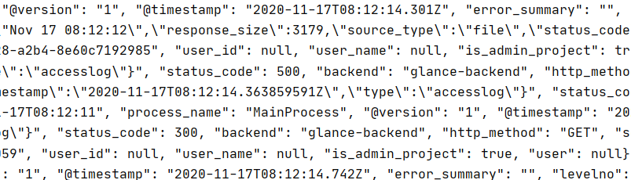
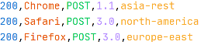

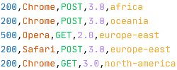
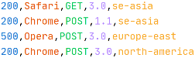

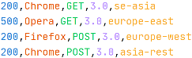
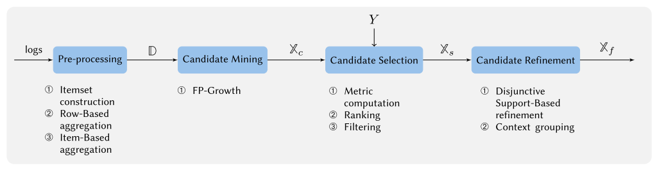
Use Case 3 Multidimensional Root-Cause Mining
Goal. Reduce troubleshooting time of access logs
Business value. Save 1h-3h of debugging depending on which information is found manually
Problem. Logs often contains the explanation of failures via the correlation of a failure with its root causes. Unfortunately, it is typically difficult to manually find these correlations
Approach. Association rules can be used to find the rules that correlate how symptoms and root-cause occur together in log records
For example, the rule {error_500} ⇒ {az=north_china, host= 169.206.0.23} indicate the root cause of the status code error_500 is caused by host 169.206.0.23 located in availability zone north_china
!
1
Customer
Error: 500
Access Logs
2
SRE operator
Structured
Logs
…
3
…
Rule Mining
algorithm
Pipeline of the LogRule algorithm. Blue boxes are algorithm phases, numbered items below are the consecutive steps taken in each phase. First, structured logs are pre-processed to construct a transactional database D. FP-Growth is then applied to generate a list of candidate explanations Xc, which are verified and selected via statistical correlation with the input failure pattern Y. Remaining explanations Xs are then refined and organized to provide a final set of explanations Xf
…
4
Probable Root-cause
Fig. Results running PoC for Use Case #3
P. Notaro, S. Haeri, J. Cardoso and M. Gerndt, "LogRule: Efficient Structured Log Mining for Root Cause Analysis," in IEEE Transactions on Network and Service Management, 2023

Slide 15
Practical Implementation
Title: Structured Log Analysis in a Web Applications
Description:
Choose a programming language and a web framework (e.g., Python with Flask, Java with Spring Boot).
Implement structured logging in the application using a logging library that supports structured data (e.g., Python's structlog, Java's Logback).
Ensure that logs include contextual information such as timestamps, log levels, user IDs, request IDs, and other relevant metadata.
Create log entries for different levels (debug, info, warning, error) during various operations within the application (e.g., user login, data retrieval, error handling)
Based on the paper "LogRule: Efficient Structured Log Mining for Root Cause Analysis” Implement a basic algorithms for root-cause analysis using logs
Deliverables
Source code of the application with structured log analysis algorithm implemented.
A report explaining the choices made for logging library, structure of log messages, use cases, and examples of RCA.

Slide 16
References
Fast dimensional analysis for root cause analysis at scale, Facebook
Sentry.io, rollbar.com, Raygun, Airbrake, Bugsnag, OverOps
JSON databases: MongoDB, CouchDB, ElasticSearch, MySQL, PosgreSQL
Structured logging at Google Cloud
https://cloud.google.com/logging/docs/structured-logging
Key foundations of logging
https://tersesystems.com/blog/2020/03/10/a-taxonomy-of-logging/
Traditional Logging versus structured logging
https://softwareengineering.stackexchange.com/questions/312197/benefits-of-structured-logging-vs-basic-logging
Why Structured logging is important
https://stackify.com/what-is-structured-logging-and-why-developers-need-it/

